Slide 1

My Career
Take charge of your career and performance

Slide 2

You are responsible for your career

Slide 3

objectives
Objectives are your goals for the year. They are determined by the Leadership Team each year. You can have your own personal goals if you would like, however, they will not be a part of your end of year review.
There are 2 types of Objectives
Performance – these are included in your review
Development – these aren’t included in your review but are used as tools to help you grow and develop in your career

Slide 4
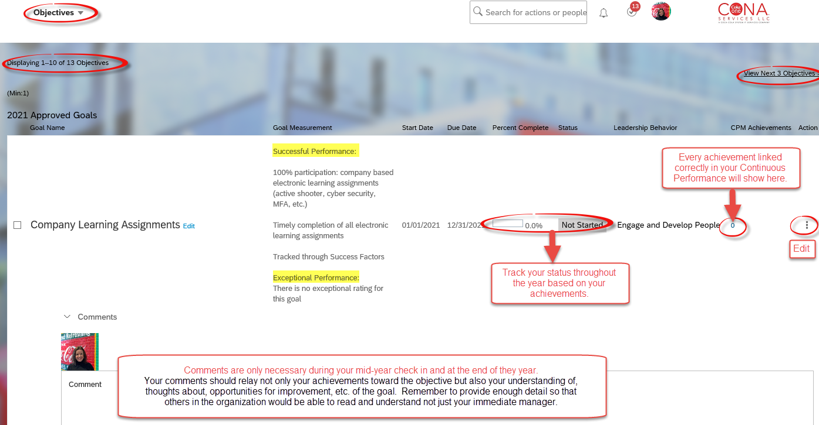
objectives

Slide 5

Activities
The Activity buckets are where you keep your manager informed of your day-to-day activities that impact your objectives. They will be reviewed in every 1:1. Depending on the Activity, you may not have an update in every 1:1. They are not a part of your end of year review.

Slide 6
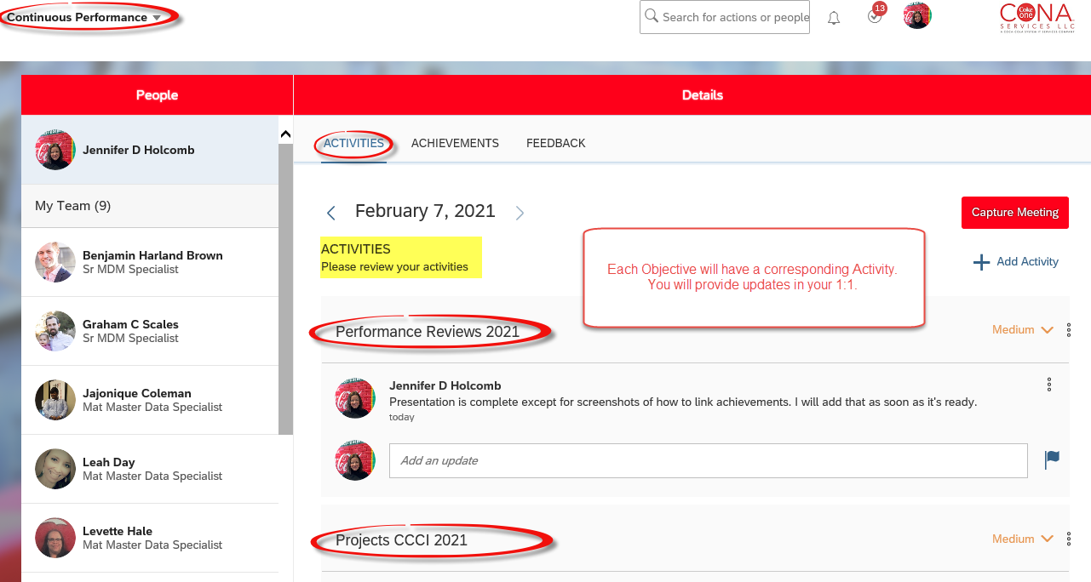
Activities

Slide 7

achievements
Achievements are a direct link to your Objectives and are used to track how you are performing against an Objective.
You can add Achievements for Performance and Development Objectives, but remember, only Performance Objectives and Achievements are shown in your review.

Slide 8
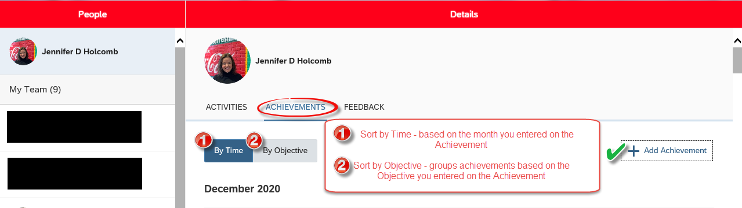
achievements

Slide 9
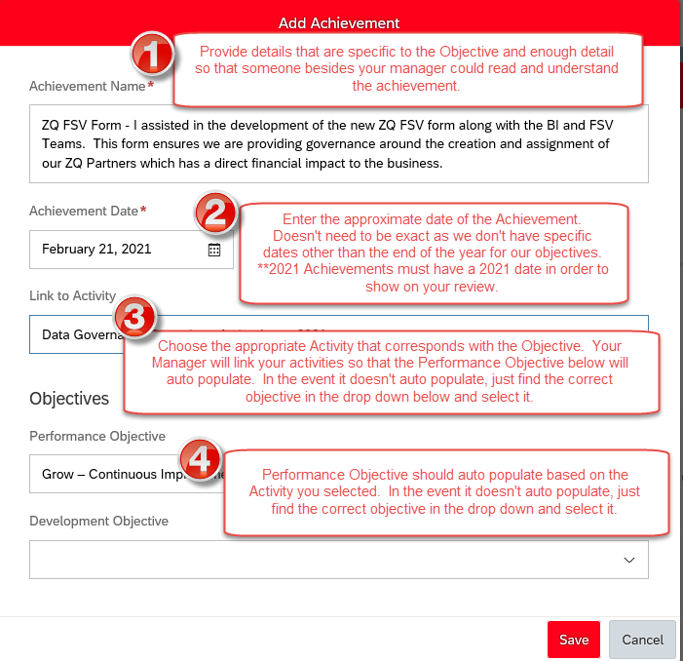

Slide 10

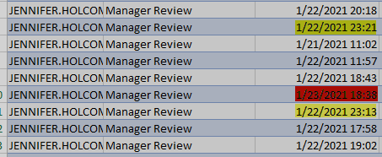
Due date
The HR Team reports to leaders companywide each area’s submission stats. They are visible down to the employee and the actual date they submitted. We came very close to not having 100% submission rates before the due date. We must change this for 2021 and going forward. It’s just too risky to wait until the last minute.
Deadline Friday 1/22 before 11:59PM
Thursday – 1 review submitted
Friday – 7 reviews submitted, 2 in the 11:00 hour.
Saturday – 1 review submitted. Thankfully the system didn’t count this as late.

Slide 11

Things to remember
When adding an Achievement, make sure it is linked to the correct Activity and Objective.
Achievements must fall within the calendar year of the review. For example, if you put the date of 1/15/2022 for a 2021 objective/goal, it will not link up in your review even if you have the correct Activity and Performance Objective. The year must correspond with the year of the review.
Only Performance Achievements will show in your review. Development Achievements will still be reviewed with your manager, but they are not a physical part of your annual review or counted in your overall rating.

Slide 12

Tips for Success for 2021
You have an Objective for 2021 called Performance Review to help ensure you are aware and tracking towards your Objectives throughout the year.
You should begin immediately planning how you will accomplish your Objectives.
Read each Objective thoroughly and make sure you understand it.
Use your 1:1 time with your manager to aid in accomplishing your Objectives.
Engage your teammates for ideas if you need help with a goal.
DO NOT wait until the last quarter to try to fit in missing meetings, education sessions, etc. Holidays and vacations make it extremely difficult to plan during this time.

